Slide 1
Employee Transportation Options
Meeting Title, Date
Presenter names

Slide 2
Note for user
The slides in this presentation have been tailored for the WMPO’s employees and policies referenced are only applicable to these employees. Organization-specific information is highlighted in yellow for ease of editing.
Please edit these slides and their template as appropriate to reflect your organization, and feel free to email Go Coast at gocoast@wilmingtonnc.gov for any assistance with identifying bus/bike routes and facilities.
Thanks!

Slide 3
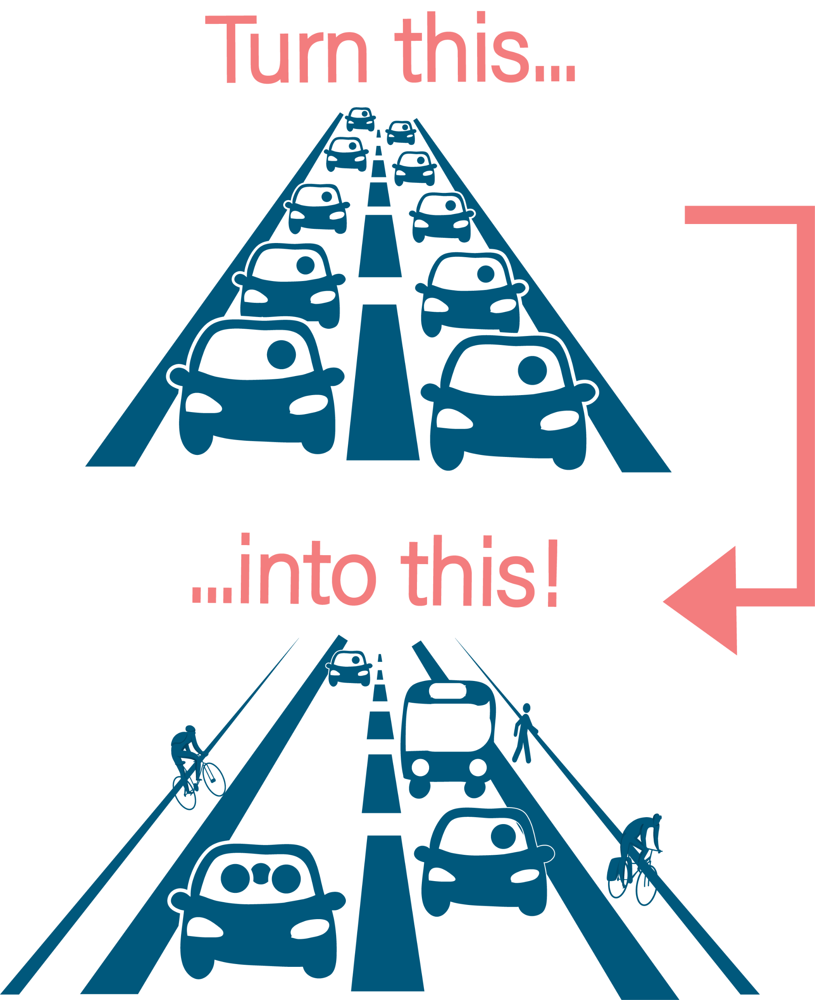
Alternative Transportation Options
Using alternative transportation options can help mitigate traffic congestion, and many other benefits –
Increased work/life balance
Save wear and tear on your personal vehicle
Improved regional air quality

Slide 4
Teleworking
Take a car off the road altogether by working from home (or another location other than the regular worksite).
With supervisor and department director approval, employees may work from home or another location. See policy 240 Alternative Work Schedules and policy 240.1 Telework Guidelines & Best Practices for more information.

Slide 5
Alternative Work Schedules
Employees, both exempt and non-exempt, may request to work a schedule other than the traditional work hours of 8am-5pm Monday through Friday. The total hours worked will be the same, but this allows an employee to move shift start/end times to accommodate scheduling needs such as childcare, high traffic congestion, or other needs.
See administrative policy 240 Alternative Work Schedules for more information.

Slide 6
Carpooling
Split the cost of gas and driving with another employee going your way.
Even carpooling just one day a week can improve traffic congestion and give passengers some time to relax without focusing on the road.
Contact HR to be added to a carpool-matching interest list.

Slide 7
Public transportation
Routes nearby: Our building at 305 Chestnut St. is 0.3 miles away from Padgett Station, which is served by many Wave Transit routes, including: 101, 108, 201, 202, 203, 205, and 210.
There’s also a stop directly in front of our building which is served by routes 108, 201, 205, and 210.
Fares: Fixed route bus fares are $2 each way, paid with cash or by using a prepaid pass.
Maps and Schedules: For bus maps and schedules visit wavetransit.com.
Rider info: Riders can request a travel training to learn how to ride the bus. Or see a how-to video. All the buses are loaded into Google Maps for transit directions.

Slide 8
Biking and walking
Downtown Wilmington has sidewalks for walkability, so if you live within a mile of 305 Chestnut St., consider walking to work.
Bicycling is also a possibility if you are comfortable riding on the road. If you live along the Oleander Dr., corridor, consider using the River to Sea Bikeway to get downtown.
See map of regional bicycle paths and facilities.

